Slide 1
ECE 3300L
Lab 8:ALU with barrel shifter
Instructor: Dr. Mohamed El-Hadedy
Sami Elias, Joseph Popoviciu

Slide 2
Objective
Use two barrel shifters to shift or rotate two separate up/down counters. Input those numbers into an ALU. Use button to select between ALU and Barrel shifter because of limited I/O ports.

Slide 3
Results
We had a clock manager to control the speed of the counters
We had two barrel shifters to shift or rotate the separate counters
We put the two values that have been shifted or rotated in an ALU
The ALU can add, subtract, or multiply
We used a button to select between ALU and barrel shifter
When the button is pressed, it will change between the two
The two most significant switches control the ALU and shifter

Slide 4
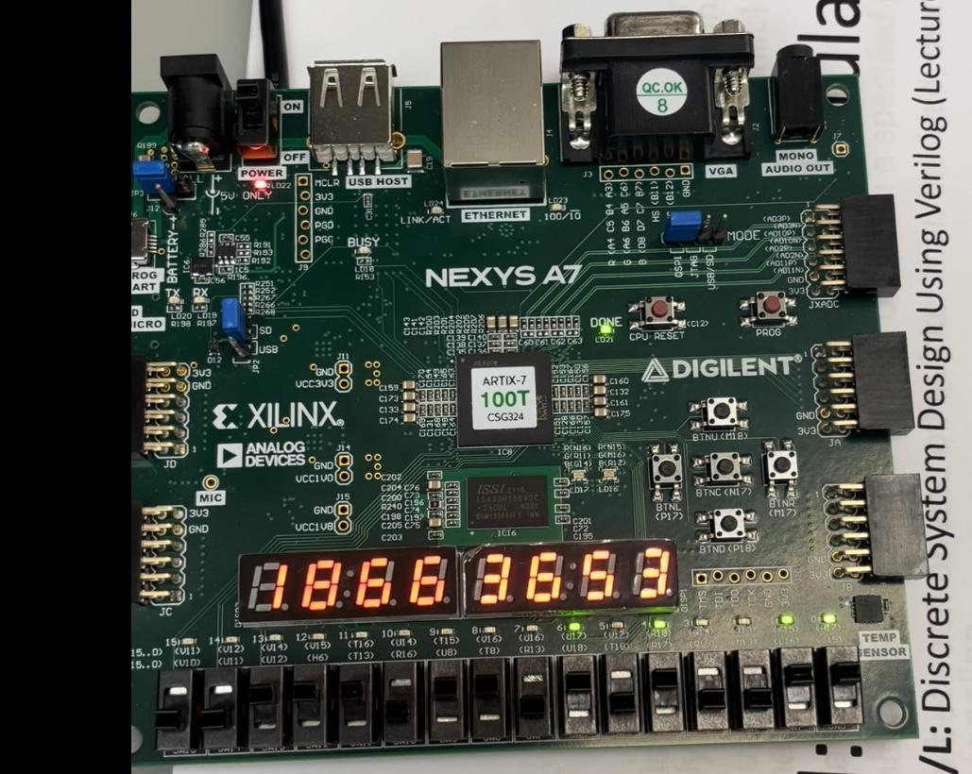

Slide 5
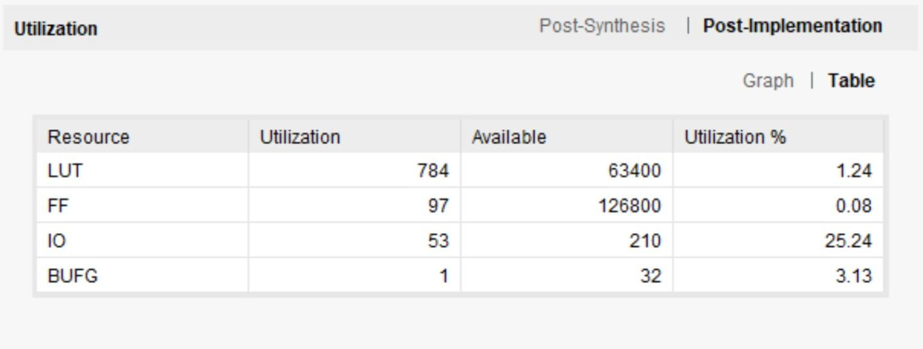
Implementation

Slide 6
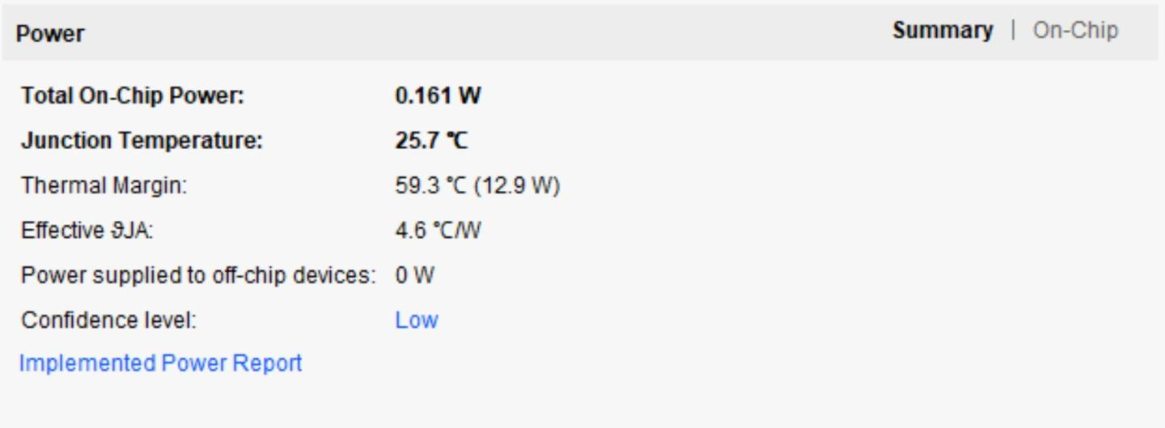
Power Consumption

Slide 7
